Slide 1
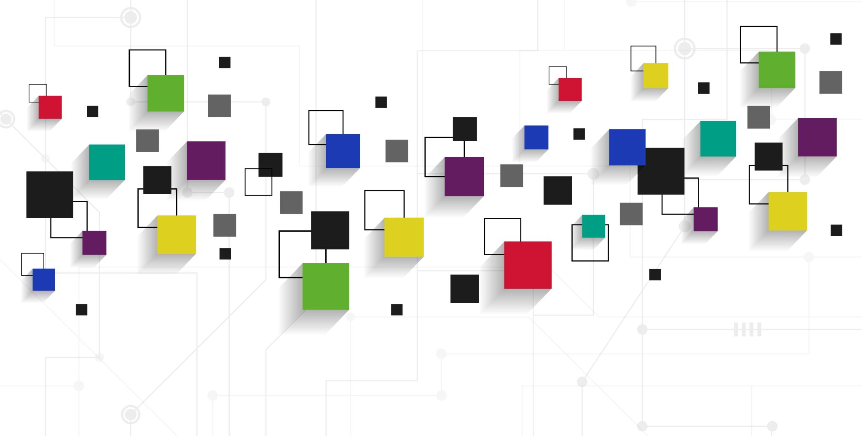
Elena’s social media & marketing

Slide 2
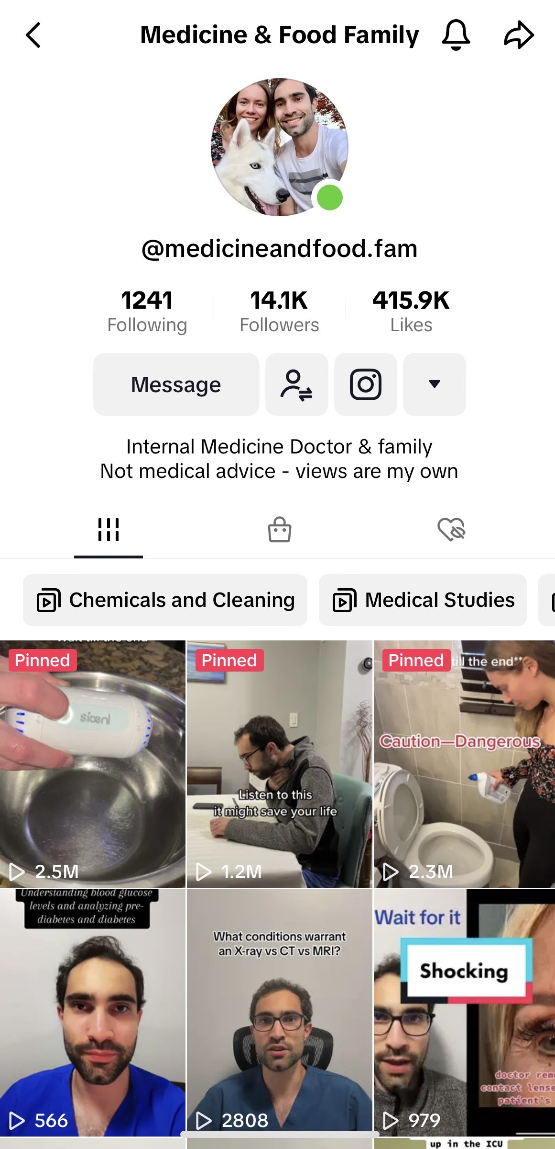
My social media
TikTok: @medicineandfood.fam 14K followers, 416K video likes, 2.5 million views on our most successful video.
Mostly, featuring my partner, Dr. Alex – Managed only by me.
https://www.tiktok.com/t/ZTRQFR6cf/
Instagram: @elenakefi – 1612 followers, 3 paid collabs.

Slide 3
EJ GOURMET LOGO DESIGN IDEation

Slide 4
NORTH SHORE FARMS – gif cREATION Example *click image to start gif

Slide 5
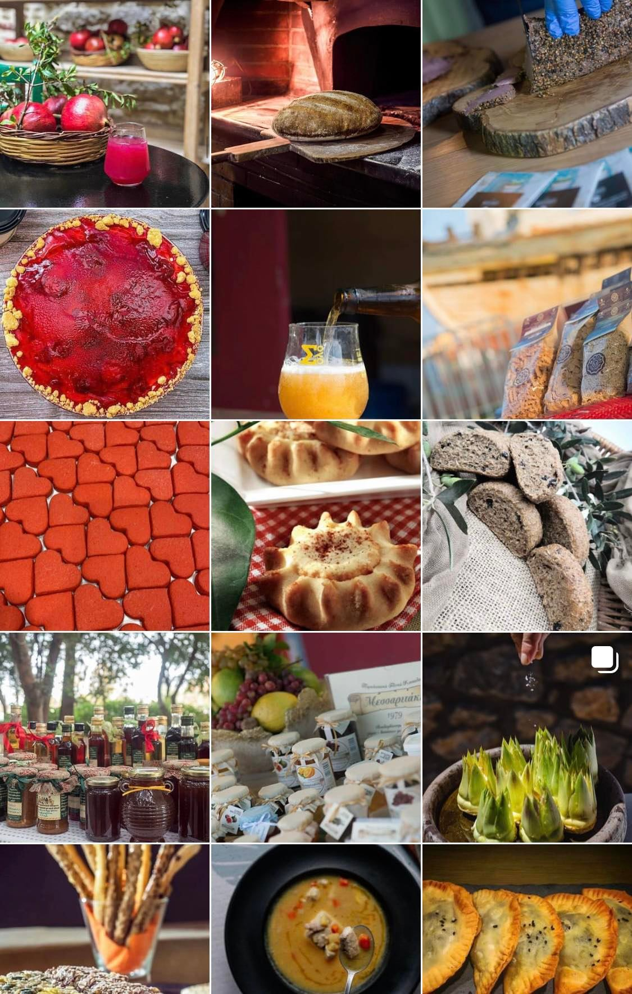
HERAKLION FLAVORS INSTAGRAM FEED and LOGO DESIGN ideation

Slide 6
National Hellenic Student Association (NHSA) FLYER

Slide 7
Artistic direction for MAKE Beauty Website & product configuration
https://www.makebeauty.com/

Slide 8
DESIGN & Part of EMAIL campaign FOR JEWERLY BRAND BY MARGO MIKIL

Slide 9
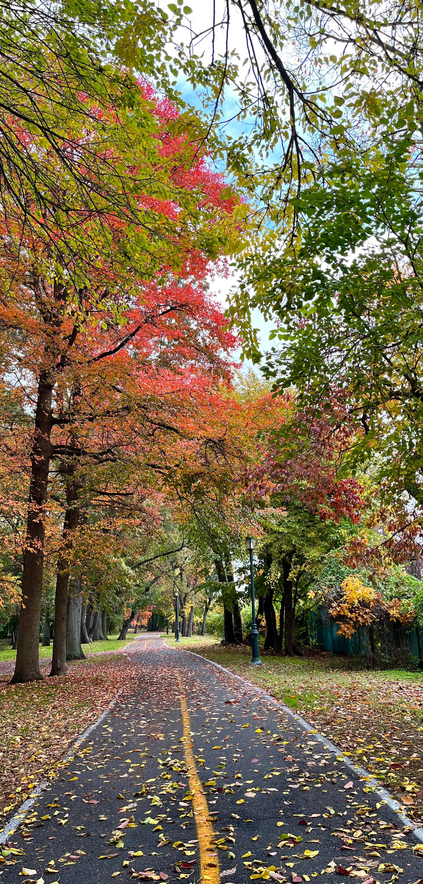
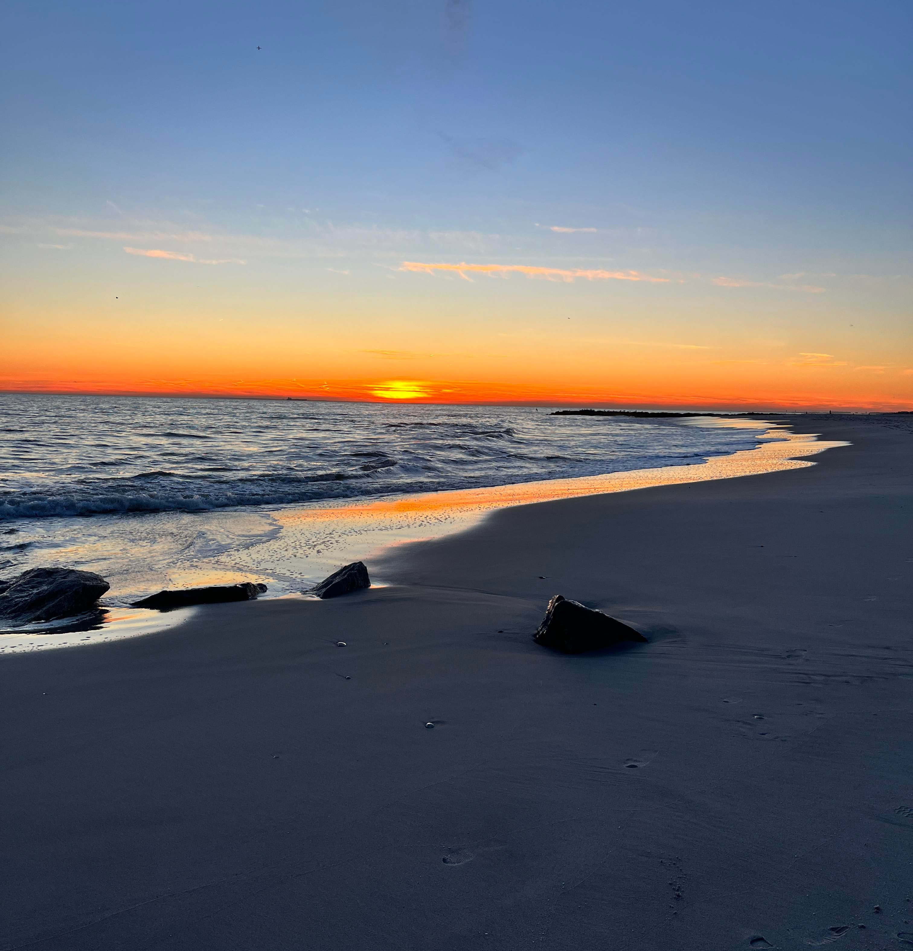
NATUREPHOTOJOURNALIST (MY PHOTOGRAPHY INSTAGRAM FEED)

Slide 10
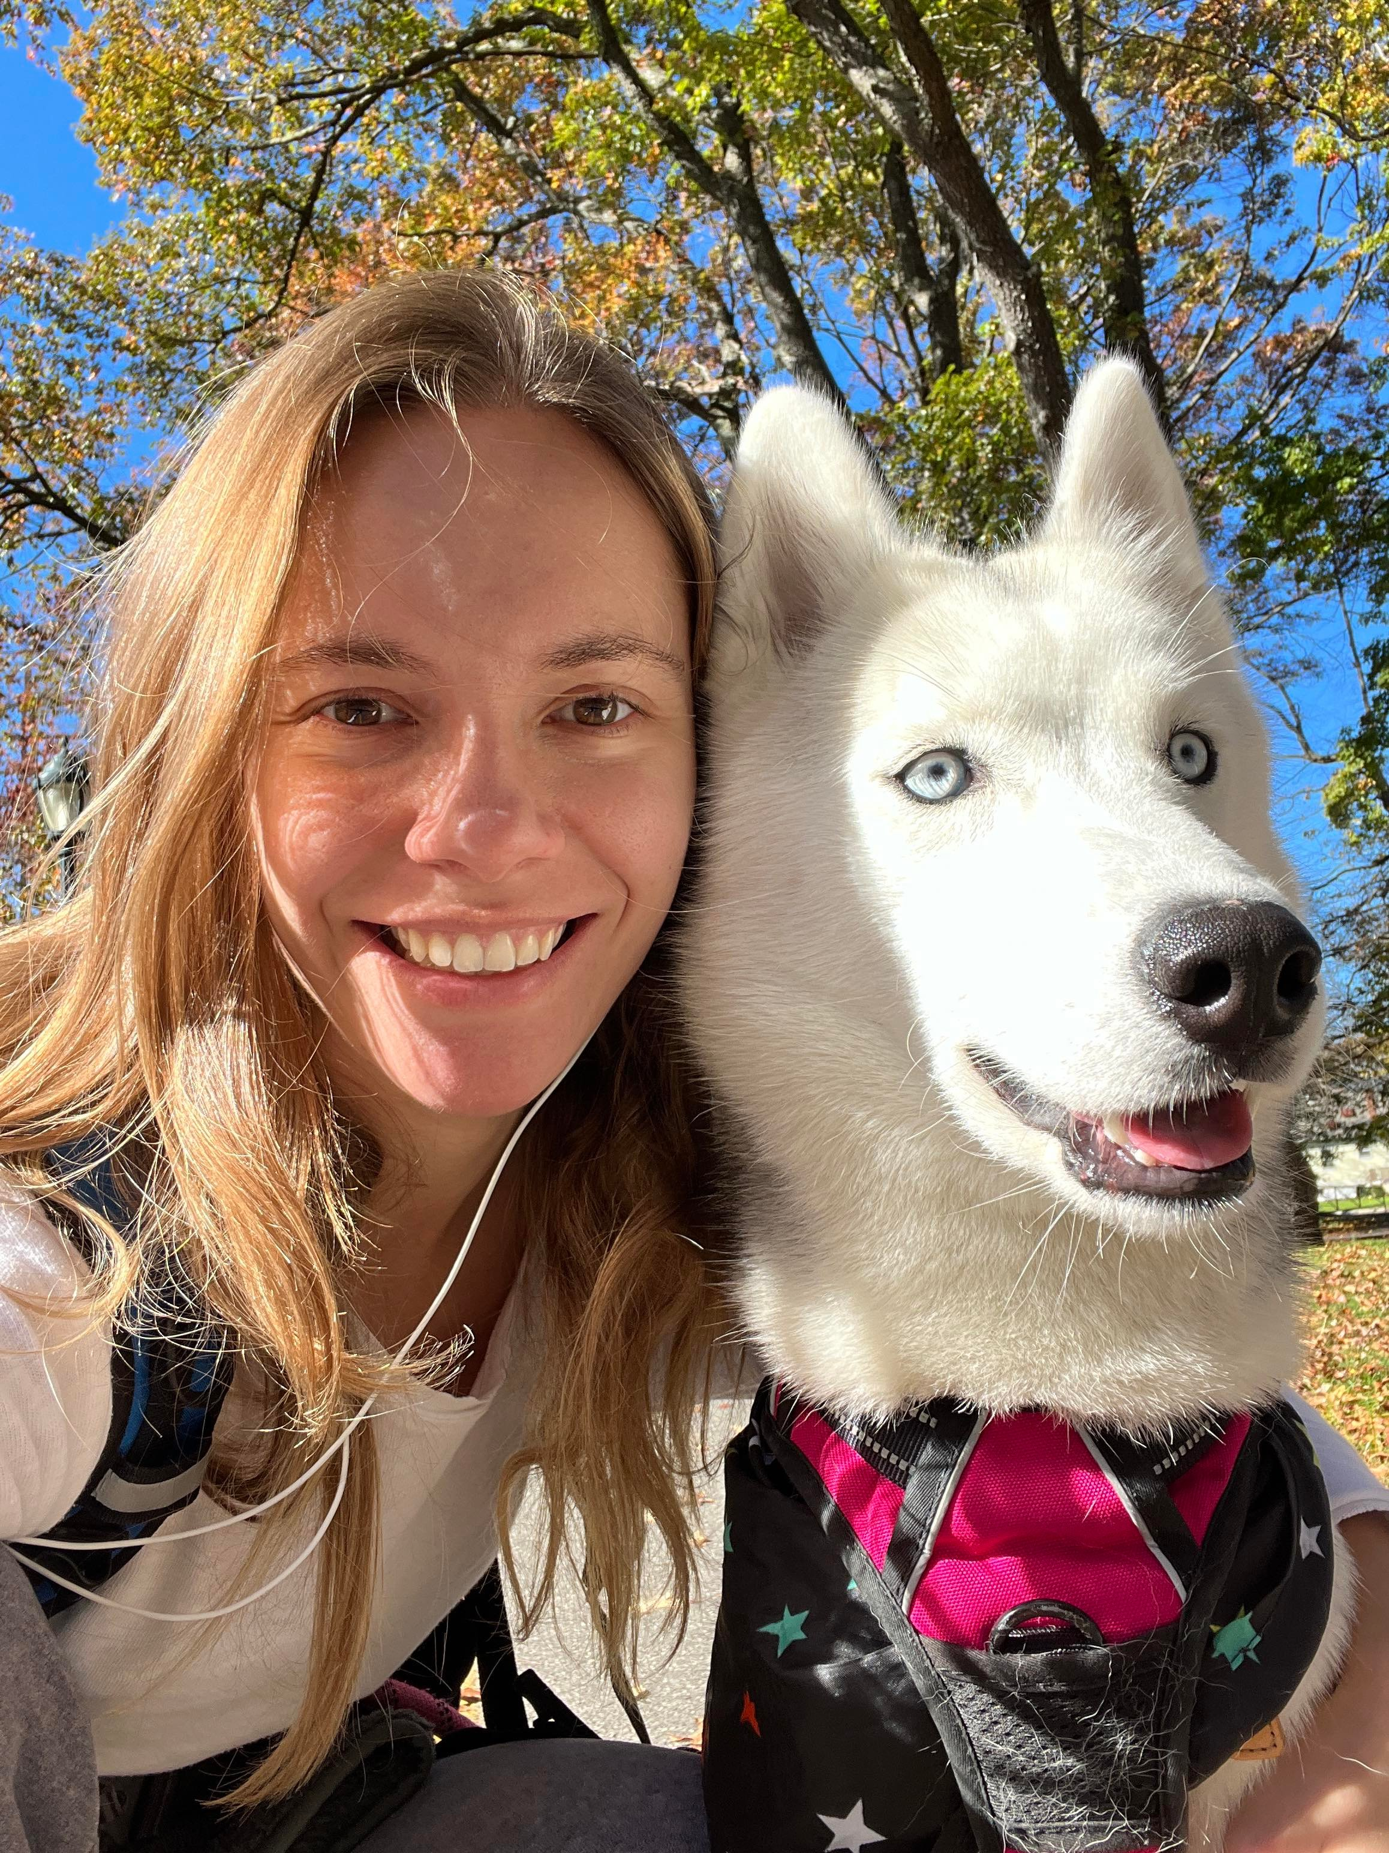
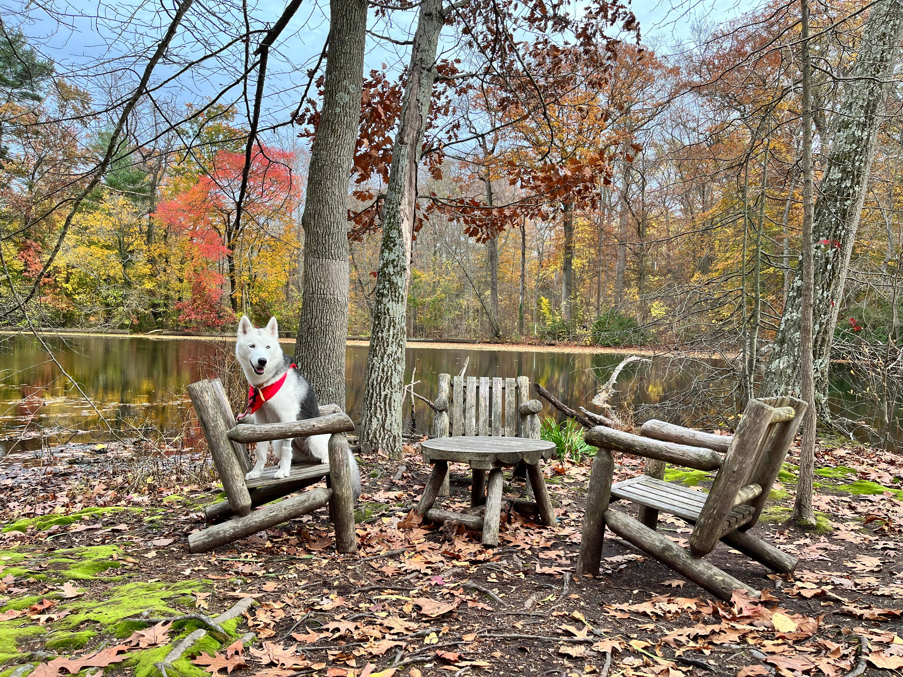
Icehusky_Angel (Angel’s INSTAGRAM FEED)

